Slide 1
5
Section 5.1
Explain the development of operating systems
Differentiate between operating systems
Section 5.2
Demonstrate knowledge of basic GUI components
Compare and contrast file systems
Explain the organization of file system directories

Slide 2
5
Section 5.3
Define and categorize network administration tools
Describe how e-mail servers work
Explain groupware and client software

Slide 3
Common Operating Systems
5.1
Guide to Reading
Main Ideas
Operating systems provide the main interface for interacting with computer hardware.
Key Terms
Uniplexed Information and Computing System (UNIX)
graphical user interface (GUI)
Disk Operating System (DOS)
Macintosh
Windows
Linux
open source

Slide 4
Common Operating Systems
5.1
UNIX
In the 1960s, a determined group of researchers developed an OS that could be used on different kinds of hardware; it was called UNIX.
Uniplex Information and Computing System (UNIX) A uniquely powerful and flexible OS that uses very little assembly language code. (p. 166)

Slide 5
Common Operating Systems
5.1
UNIX
UNIX was developed in a programming language that was independent of the hardware on which it needed to operate.
Most versions of UNIX do not have a graphical user interface (GUI) but in recent years a lot of work has been done to make UNIX easier to use.
graphical user interface (GUI) A computer interface that replaces typed commands. Makes computing easy by allowing users to click a mouse and graphical icons to manage files within the OS. (p. 167)

Slide 6
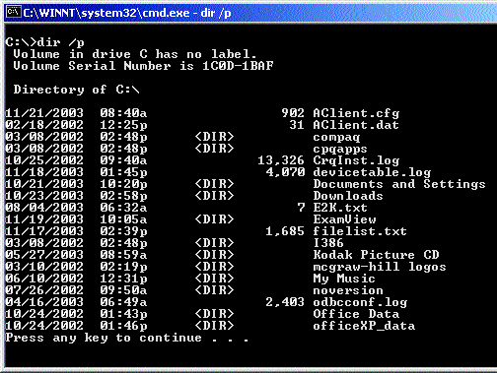
Common Operating Systems
5.1
DOS
In the 1980s, IBM and Microsoft developed Disk Operating System (DOS).
There is no GUI for DOS. All commands are entered at the command prompt.
Disk Operating System (DOS) A command driven operating system capable of performing many important tasks, such as file and directory management, disk formatting, and simple text editing. (p. 167)

Slide 7
Common Operating Systems
5.1
Macintosh Operating System
In 1984, Apple Computers introduced the Macintosh OS, which used a GUI and a mouse to manage files.
Apple’s OS X uses UNIX as its underlying architecture, making it more stable and easier to customize that it had been in the past.
Macintosh A model of computer made by Apple. Features a GUI-type OS in which users click graphical icons to manage files. See also GUI. (p. 168)

Slide 8
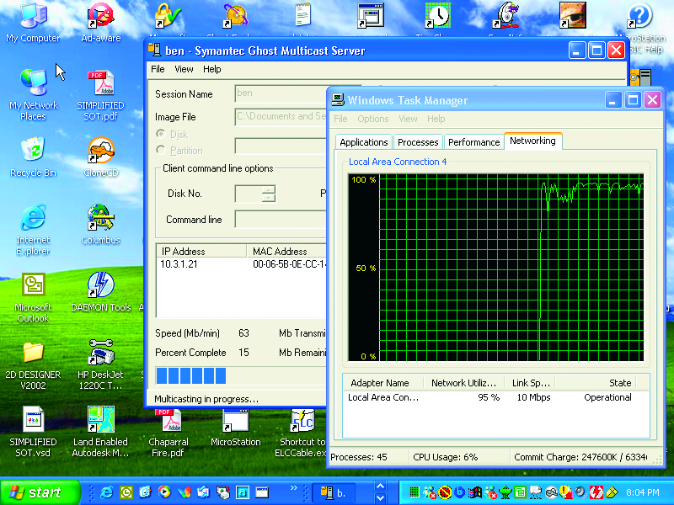
Common Operating Systems
5.1
Microsoft Windows
The Microsoft answer to the Macintosh OS was Windows. Initially just a GUI on top of DOS, Windows has evolved into the OS of choice on nearly 90% of all computers.
Windows A family of OSs created by Microsoft. (p. 169)

Slide 9
Common Operating Systems
5.1
Novell Netware
Novell’s NetWare OS is different from other OS in that it is technically a network operating system.
NetWare can run on any hardware, including Macintosh, UNIX, and Windows-based computers.

Slide 10
Common Operating Systems
5.1
LINUX
Linux has gained popularity as an alternative to Windows.
It is an open source application, and is completely free to anyone who wants to download the files and set it up.
Linux A derivative operating system of UNIX. It has gained popularity as an alternative to Microsoft Windows. (p. 170)
open source Programming code that is available to anyone. Linux was made of this, which meant that anyone was free to add and improve on the code. (p. 170)

Slide 11
Common Operating Systems
5.1
You Try It
Activity 6A – Using DOS Commands (p. 167)

Slide 12
Graphical User Interface
5.2
Guide to Reading
Main Ideas
The graphical user interface includes icons, and menus which organize related commands, and make computers easier to use. Help systems aid users learning about the software. File system directories organize files to provide easy, organized access to data.
Key Terms
menu system
file system directory
tree structure
file allocation table (FAT)
NT file system (NTFS)
Hierarchical File System (HFS)
Extended File System Version 2 (EXT2)

Slide 13
Graphical User Interface
5.2
Parts of the GUI Window
In the Windows OS, each application runs in its own “window.”
The windows concept allows users to run many applications at the same time and quickly switch between them.

Slide 14
Graphical User Interface
5.2
Parts of the GUI Window
Icons and menu systems are two ways to organize and access commands and information within an application.
menu system A method used primarily in GUI systems to organize commands and information within an application. (p. 174)

Slide 15
Graphical User Interface
5.2
Help Systems
Help systems are available with almost every software applications.
Sometimes, the help documentation is in simple text files. More often, the help files are highly organized, graphical help systems with pictures, hyperlinks, and animations.

Slide 16
Graphical User Interface
5.2
File System Directories
An essential part of any OS is the file system directory. Most OSs use a tree structure to show the files stored on disk.
file system directory A system tool used to display the organizational structure of the files stored on the hard drives, network drives, and other removable storage devices, such as Zip disks or CD-R disks. (p. 175)
tree structure A structure in OSs representing the files stored on disk. The drive often represents a “root,” or base, that has folders or directories for its branches. (p. 175)

Slide 17
Graphical User Interface
5.2
File System Directories
Different OSs have different ways of storing files. These file systems have different capabilities in regard to securing access, file compression, and physical storage of data on the disk.
FAT/FAT32
NTFS
HFS
EXT2
file allocation table (FAT) A file storage system used by the Windows 9x line of operating systems (and optionally by operating systems based on Windows NT). FAT32 is an extension to FAT, which uses 32 bits to store a file’s address location. (p. 176)
NT file system (NTFS) A file storage system used by the Microsoft Windows NT-based operating systems (Windows 2000 and Windows XP). It allows an administrator to set access permissions for directories and/or individual files. (p. 176)

Slide 18
Graphical User Interface
5.2
File System Directories
HFS
EXT2
Hierarchical File System (HFS) A Mac OS file storage system. Files are normally stored as two “forks” or parts. (p. 176)
Extended File System Version 2 (EXT2) The most common file storage system on Linux systems. (p. 176)

Slide 19
Graphical User Interface
5.2
You Try It
Activity 6B – Using Online Help
Activity 6C – Sharing Folders with Peers

Slide 20
Network Operating System Software
5.3
Guide to Reading
Main Ideas
All network operating systems provide administrative tools and security utilities. Network services are used for e-mail, groupware, and other important business functions.
Key Terms
administrative tools
domain
group
Microsoft Active Directory
Novell Directory Services (NDS)
Post Office Protocol (POP)
Simple Mail Transfer Protocol (SMTP)
groupware

Slide 21
Network Operating System Software
5.3
Administrative Tools
One of the key differences between an OS and a NOS are the administrative tools that are part of the NOS.
Each of the major NOSs has its own organization scheme and set of administrative tools.
administrative tools The network operating system tools available for network administrators to manage servers, users, and resources from virtually anywhere on the network. (p. 179)

Slide 22
Network Operating System Software
5.3
Administrative Tools
NOSs use directory services to organize and manage objects that belong to the network.
These directory services allow administrators to manage domains, user accounts, and groups.
domain A grouping of computers and devices that are administered as one unit. (p. 179)
group An account of users. An administrator can easily add or remove users in the group. A group is used to automatically assign permissions to many users at once. (p. 179)

Slide 23
Network Operating System Software
5.3
Administrative Tools
Both Microsoft and Novell have their own directory structures.
Microsoft Active Directory
Novell Directory Service
Microsoft Active Directory The central database system for administering the network. (p. 180)
Novell Directory Services (NDS) The central administration application for NetWare-based networks. (p. 180)

Slide 24
Network Operating System Software
5.3
Administrative Tools
Network security is important and many different methods exist to secure a network.
Policies and Permissions
Event Notification Tools
External Threats
Network Backup and Recovery Utilities

Slide 25
Network Operating System Software
5.3
Other Server Software
Servers also run a number of other specialized software applications. Some servers are dedicated to a specific purpose.
An email server uses Post Office Protocol (POP) and Simple Mail Transfer Protocol (SMTP) to receive and sent messages.
Post Office Protocol (POP) A server assigned to receiving and scanning incoming messages and organizing them by the addressee. (p. 182)
Simple Mail Transfer Protocol (SMTP) A server assigned to resolving outgoing messages’ domain names into IP addresses. (p. 182)

Slide 26
Network Operating System Software
5.3
Other Server Software
Groupware, or workgroup productivity software is divided into two groups:
Centralized scheduling software
Remote collaboration software
groupware A name that represents a special class of software referred to as “workgroup” software. (p. 183)

Slide 27
Network Operating System Software
5.3
Client Software
Client software, such as Microsoft Outlook, runs on the client machine, rather than the server.
In some networks, such as Novell NetWare, client software is used for all network access functions.

Slide 28
Network Operating System Software
5.3
You Try It
Activity 6D – Configuring E-mail Accounts (p. 182)

Slide 29
Chapter 5
Resources
For more resources on this chapter, go to the Introduction to Networks and Networking Web site at http://networking.glencoe.com.

